Slide 1
Chapter 3
C PROGRAMMING FOR 8051

Slide 2
CONTENTS
3.1. Introduction
3.2. C programming for microcontrollers
3.3. I/O programming
3.4. Logic programming
3.5 Timer/ Counter programming
3.6. Serial programming
3.7. Interupt programming

Slide 3
3.1. Introduction
Why program 8051 in C
Compiler proceduce hex files that is downloaded to ROM of microcontroller
C programming is less time consuming, but has larger hex file size
The reasons for writing programs in C.

Slide 4
3.1. Introduction
Data types
Unsigned char
Signed char
Unsigned int
Signed int
Sbit
Bit and sfr

Slide 5
3.2. C programming for microcontrollers
Time delay
Using a simple for loop
Using 8051 timer
Ex 3.1: Write an 8051 C program to toggle bits of P1 continuously forever with some delay
Ex 3.2: Write an 8051 C program to toggle bits of P1 continuously with some a 250ms.

Slide 6
3.3. I/O programming
Byte size I/O
Ex 3.3: LEDs are connected to bits P1 and P2. Write an 8051 C program that shows the count from 0 to FFH on the LEDs.
Ex 3.4: Write an 8051 C program to get a byte of data form P1, wait ½ second, and then send it to P2.
Ex 3.5: : Write an 8051 C program to get a byte of data form P0, wait ½ second. If it is less than 100, sen it to P1; otherwise, and then send it to P2.

Slide 7
3.3. I/O programming
Bit-addressable I/O
Ex 3.6: Write an 8051 C program to toggle only bit P2.4 continuously without disturbing the rest of the bits of P2.
Ex 3.7: Write an 8051 C program to monitor bit P1.5. If it is high, send 55h to P0; otherwise, and then send AAh to P2
Ex 3.8: A door sensor is connected to the P1.1 pin, and a buzzer is connected to P1.7. Write an 8051 program to monitor the door sensor, and when it opens, sound the buzzer. You can sound the buzzer by sending a square wave of a few hundred Hz.
Ex 3.9: The data pins of an LCD are connected to P1. the information is latched into the LCD whenever its Enable pin goes from high to low. Write an 8051 C grogram to send “The Earth is but One Country” to this LCD.

Slide 8
3.3. I/O programming
Accessing SFR Addresses 80 - FFH
Ex 3.10: Write an 8051 C program to turn bit P1.5 on and off 50,000 times.
Ex 3.11: Write an 8051 C program to get the status of P1.0, save it, and send it to P2.7, continuously.

Slide 9
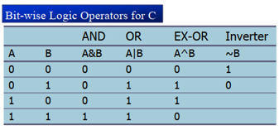
3.4. Logic programming
Bit-wise operators on C
Logical operators
AND (&&), OR (||), NOT (!)
Bit-wise operators
AND (&), OR (|), Inverter (~), Shift Right (>>), Shift Left (<<)

Slide 10
3.4. Logic programming
Bit-wise operators on C
Ex 3.12: Write an 8051 C program to toogle all the bits of P0 and P2 continuously with a 250ms delay. Using the inverting and Ex-OR operators, respectively.
Ex 3.13: Write an 8051 C program to bet bit P1.0 and send it to P2.7 after inverting it.

Slide 11
3.4. Logic programming
RAM data space usage by 8051 C compiler
Bank 0 – addresses 0-7
Individual variables – addresses 08 and beyond
Array elements – addresses right after variables
Stack – addresses right after array elements.

Slide 12
3.4. Logic programming
Data serialization
A way of sending a byte of data one bit at a time through a single pin of microcontroller
Using the serial port
Transfer data one bit a time and control the sequence of data and spaces in between them
Ex: Write a C program to send out the value 44H serially one bit at a time via P1.0: the LSB should go first out first.
Ex: Write a C program to send out the value 44H serially one bit at a time via P1.0: the MSB should go first out first.

Slide 13
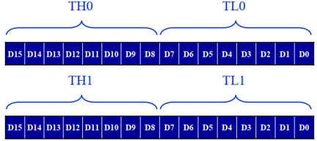
3.5 Timer/ Counter programming
Timers programming
Two timers/counters
16 bits wide
Low byte and high byte

Slide 14

3.5 Timer/ Counter programming
Timers programming
TMOD register: 8 bit
The lower 4 bits are for Timer 0
The upper 4 bits are for Timer 1

Slide 15

3.5 Timer/ Counter programming
Mode 1 programming
It is a 16-bit timer; therefor, it allows value of 0000 to FFFFh to be loaded into the timer’s register TL, TH
After TH and TL are loaded with a 16-bit initial value, the timer must be started
After the time started, it starts to count up until FFFFH
When it rolls over from FFFFh to 0000, it sets high a flag bit called TF (TF0, TF1)
When this timer flag is raised, one option would be to stop the timer with the instruction CLR TR0 or CLR TR1.
After the timer reaches its limit and rolls over, in order to repeat the process

Slide 16
3.5 Timer/ Counter programming
Mode 1 programming
Finding the loaded Timer value
Assume XTAL = 11.0592 MHz, we can use the following steps for finding the TH, TL registers’s values
Divide the designed time delay by 1.085us
Perform 65536 – n, where n is the decimal value we got in Step 1
Convert the result of step 2 to hex, yyxx
Set TL = xx, and TH yy

Slide 17
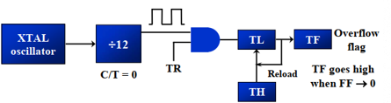
3.5 Timer/ Counter programming
Mode 2 programming
8 bit timer: 00 – FFh
After TH is loaded with the 8 bit value, the 8051 gives a copy of it to TL
After the timer is started, it starts to count up by incrementing the TL register
When the TL register rolls from FFh to 0 and TF is set to 1, TL is reloaded automatically with the original value kept by the TH register

Slide 18
3.5 Timer/ Counter programming
Mode 2 programming
Load the TMOD value register indicating which timer is to be used, and the timer mode is selected
Load the TH registers with the initial count value
start timer
Keep monitoring the timer flag (TF) with the JNB TFx, target instruction to see whether it is raised
Clear the TF flag
Go back to Step 4 since mode 2 is autoload

Slide 19
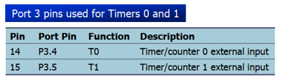
3.5 Timer/ Counter programming
Counter programming
Timers can also be used as counters counting events happing outside the 8051
The C/T bit in the TMOD registers decides the source of the clock for the timer

Slide 20
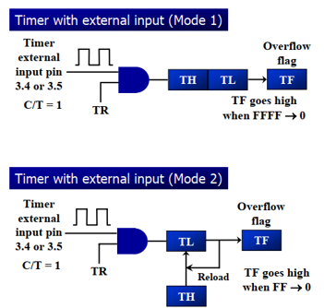
3.5 Timer/ Counter programming
C/T bit in TMOD Register

Slide 21
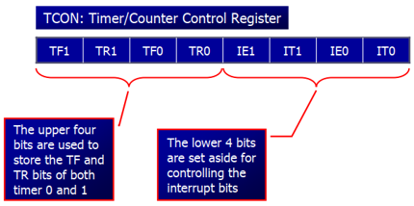
3.5 Timer/ Counter programming
TCON register
8 bit

Slide 22
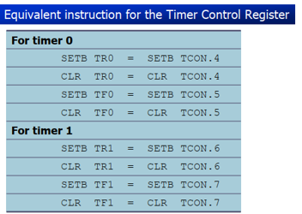
3.5 Timer/ Counter programming
TCON register
A bit-addressable register

Slide 23
3.5 Timer/ Counter programming
Ex: Write an 8051 C program to toogle all the bits of port P1 continuously with some delay in between. Use Timer 0, 16 bit mode to generate the delay.
Ex: Write an 8051 C program to toogle only bit P1.5 continuously every 50ms. Use Timer 0, mode 1, 16 bit mode to generate the delay.

Slide 24
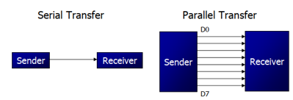
3.6. Serial communication
Serial communication
Computer transfer data in two ways:
Parallel and Serial
Two method: synchronous and assynchronous

Slide 25
3.6. Serial communication
Serial communication
Ex: Write an 8051 C program to transfer the message “YES” serially at 9600 baud, 8-bit data, 1 stop bit. Do this continuously.
Ex: Program the 8051 in C to receive bytes of data serially and put them in P1. Set the baud rate at 4800, 8 bit data, and the 1 stop bit.

Slide 26
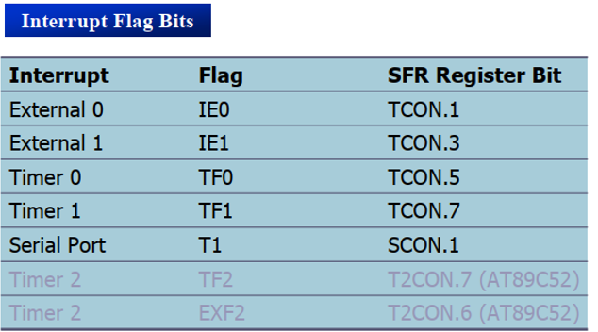
3.7. Interupt programming
The TCON register holds four of the interrupt flags, in the 8051 the SCON register has the RI and TI flags.
Notes:
165

Slide 27
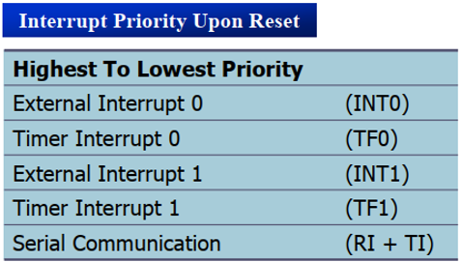
3.7. Interupt programming
When the 8051 is powered up, the priorities are assigned according to the following
Notes:
165

Slide 28
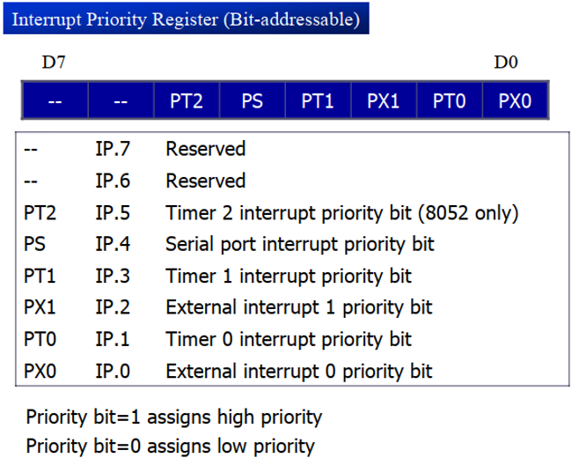
3.7. Interupt programming

Slide 29
3.7. Interupt programming
Ex: Write a C program that continously gets a single bit of data from P1.7 and sends it to P1.0, while simultaneously creating a square wave of 200us priod on pin P2.5. Use timer 0 to create the square wave. Assume that XTAL = 11.0592 MHz.
Ex: Write a C program using interrupts to do the following:
a. Receive data serically and send it to P0.
b. Read port P1, transmit data serially, and give a copy to P2
c. make timer 0 generate a square wave of 5kHz frequency on P0.1. Assume that XTAL = 11.0592 MHz. Set the baud rate at 4800.

